Slide 1
Esp8266 Server
Advanced Arduino IDE and Esp8266

Slide 2
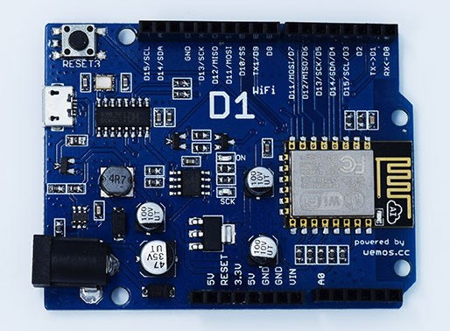
Wemos D1 ESP8266 based board
All GPIO work with 3.3 voltages

Slide 3
Pin (On Board) | Function | ESP-8266 Pin (Coding)
D0 | RX | GPIO3
D1 | TX | GPIO1
D2 | IO | GPIO16
D3(D15) | IO,SCL | GPIO5
D4(D14) | IO,SDA | GPIO4
D5(D13) | IO,SCK | GPIO14
D6(D12) | IO,MISO | GPIO12
D7(D11) | IO,MOSI | GPIO13
D8 | IO,Pull-up | GPIO0
D9 | IO,pull-up, BUILTIN_LED | GPIO2
D10 | IO,pull-down,SS | GPIO15
A0 | Analog Input | A0
* All digital i/o can performance PWM output

Slide 4
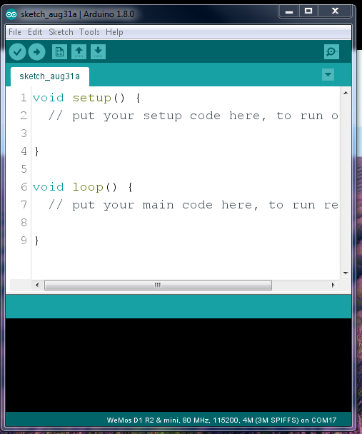
File → Examples → ESP8266WebServer → HelloServer

Slide 5
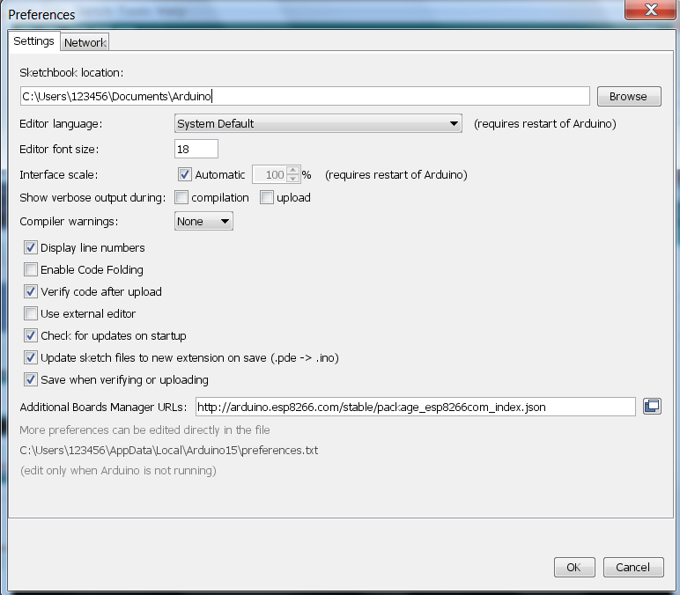

Slide 6
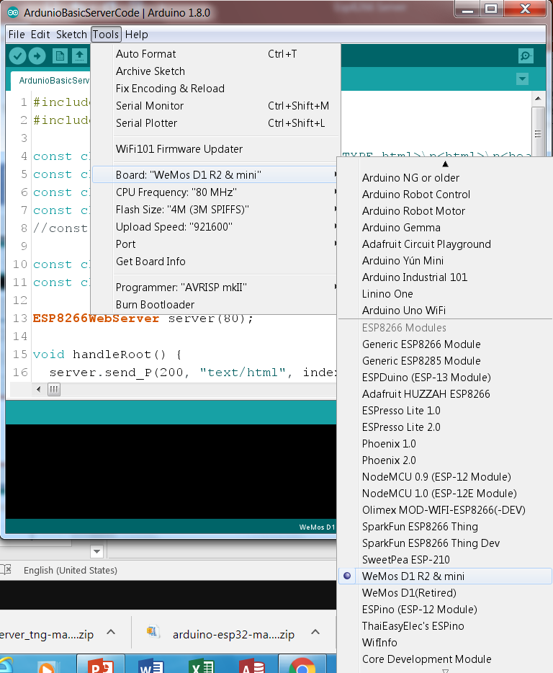

Slide 7
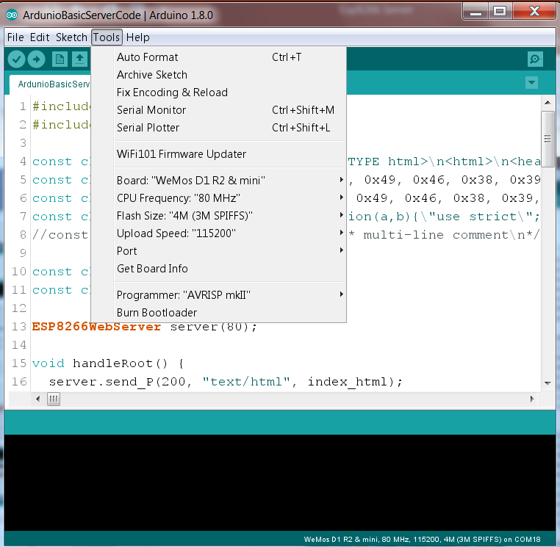

Slide 8
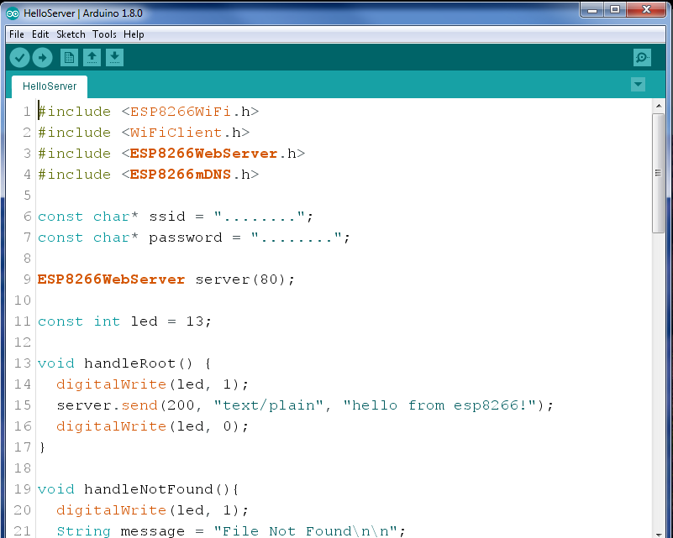
ใส่ชื่อเครือข่าย เช่น “truemove”
ใส่รหัสผ่าน เช่น “123456”

Slide 9
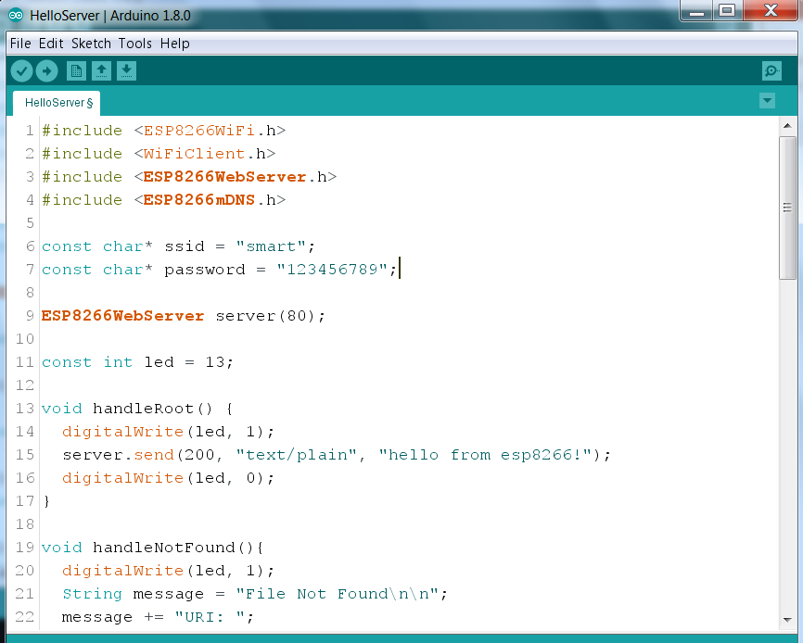
Upload to esp8266

Slide 10
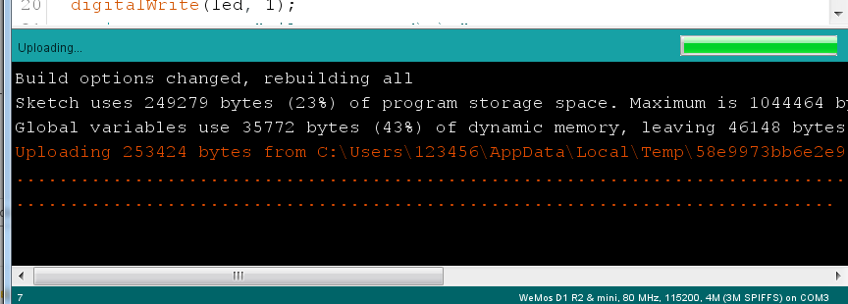
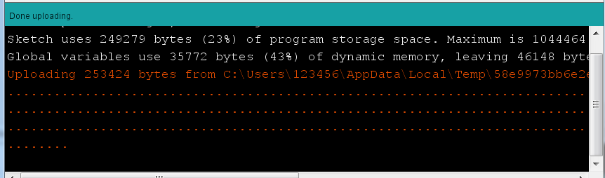

Slide 11
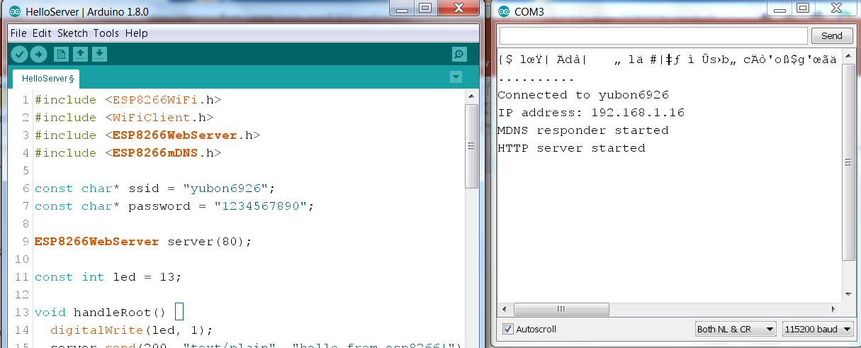
Open serial monitor
Got ip address
Select baud rate 115200

Slide 12
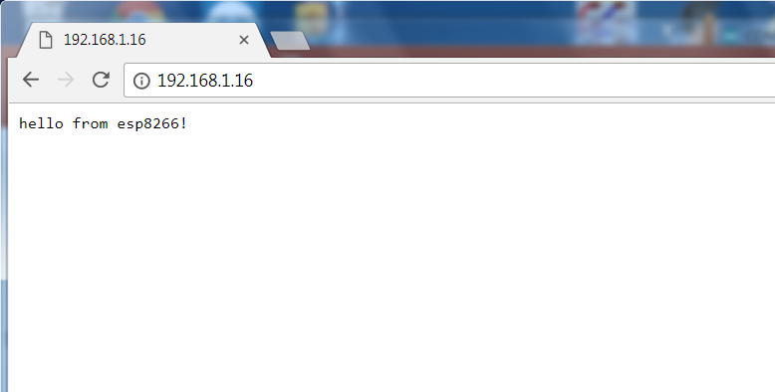

Slide 13
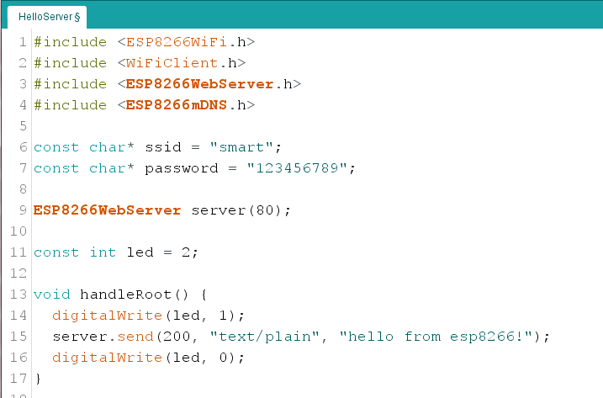
Change to 2 for builtin LED
Text to display on browser
Led on and off each time sending to browser

Slide 14
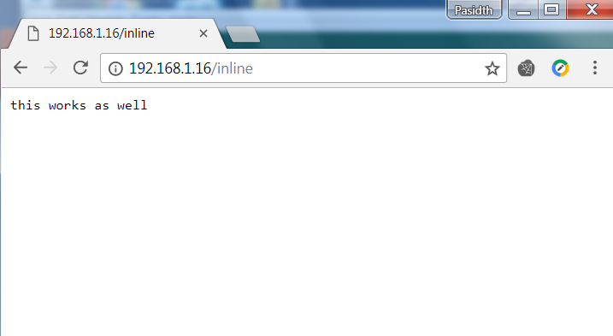
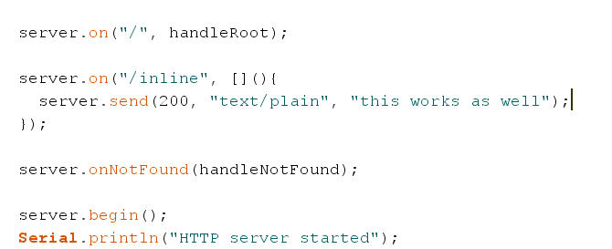
Request command
Send text

Slide 15
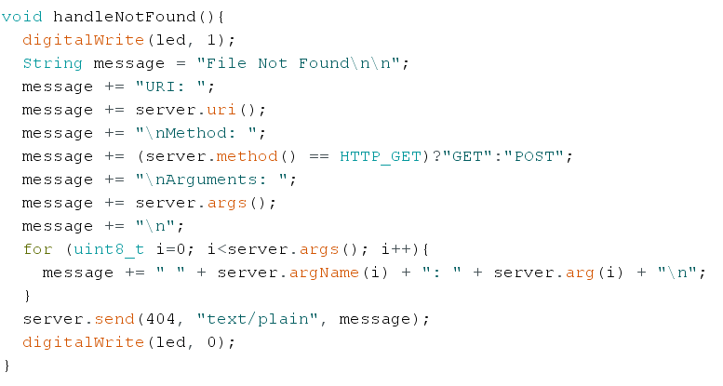
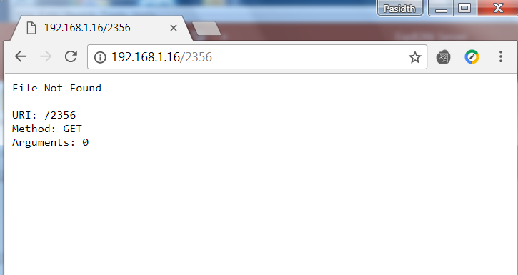
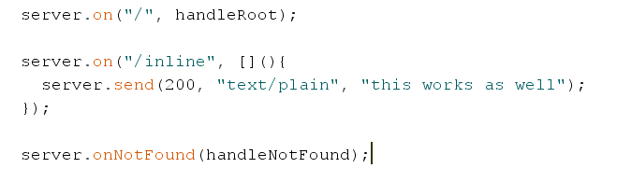

Slide 16
Exercise 1-1
เพิ่มคำสั่ง /on สั่งให้ LED on, /off สั่งให้ LED off และส่งข้อความกลับมาที่ browser

Slide 17
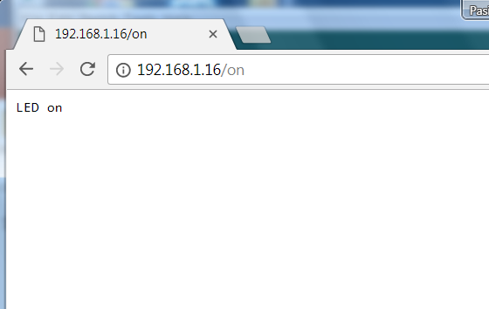
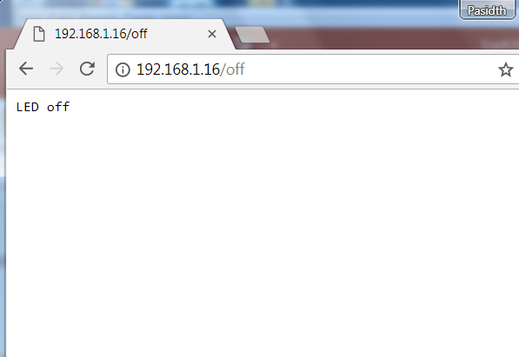

Slide 18
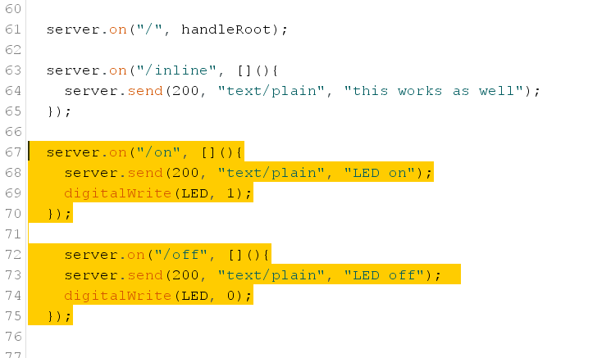

Slide 19
Put HTML to Arduino Sketch

Slide 20
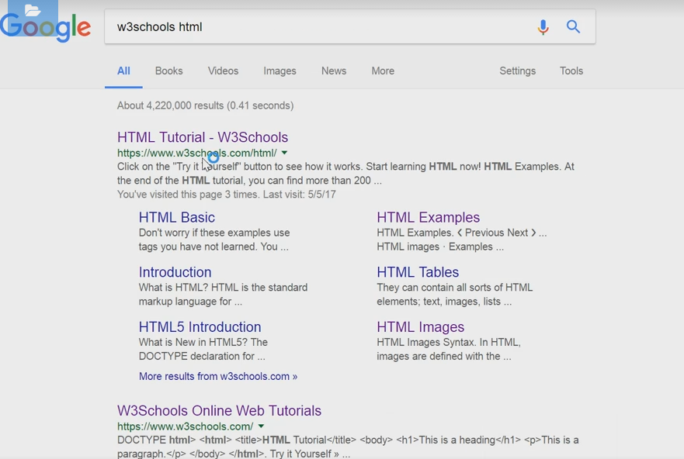

Slide 21
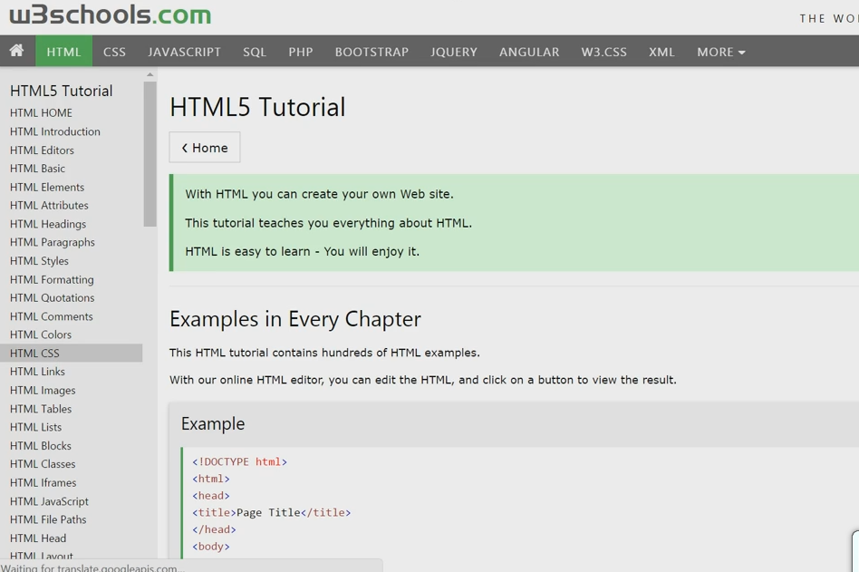

Slide 22
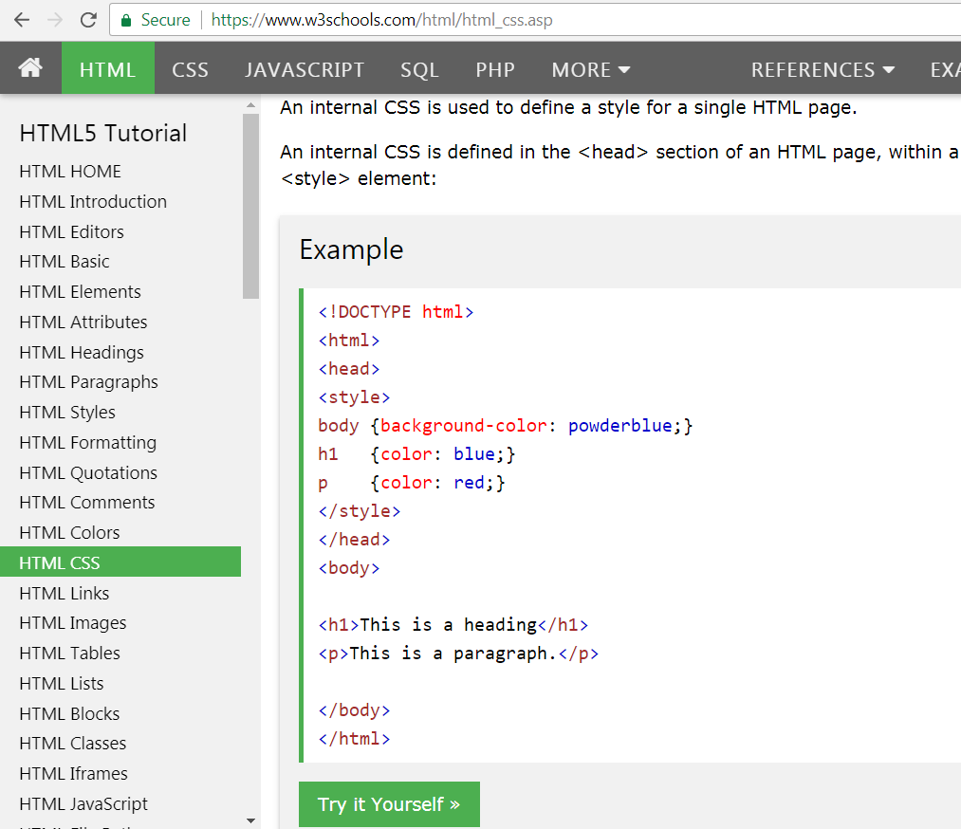

Slide 23
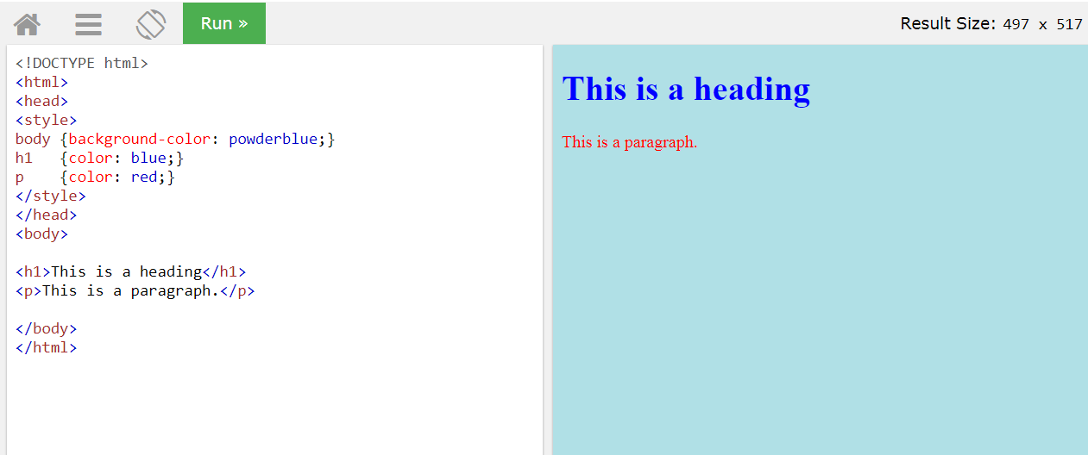

Slide 24
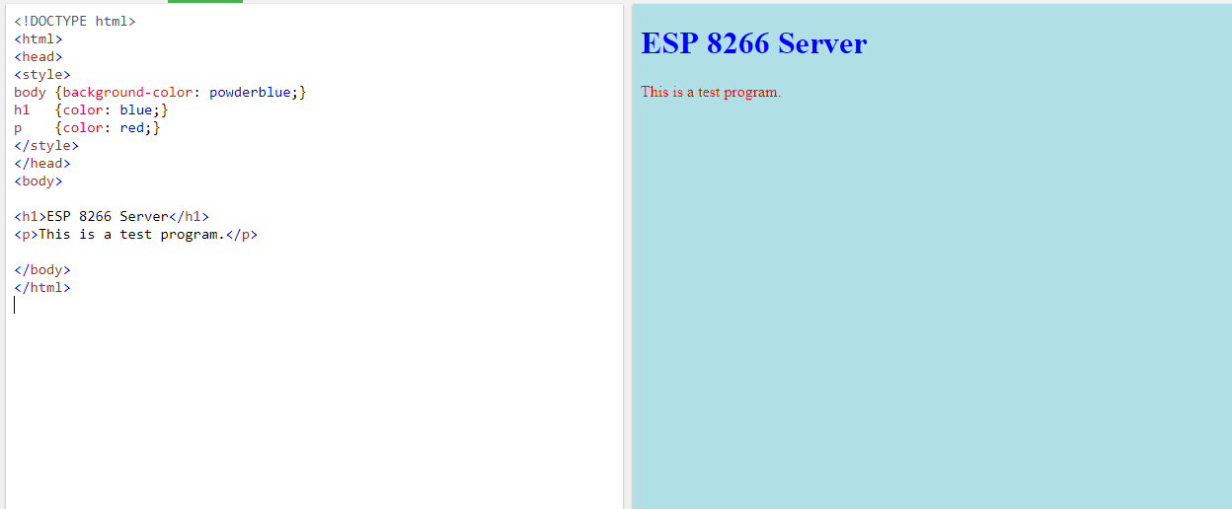
Convert to string format for Arduino sketch

Slide 25
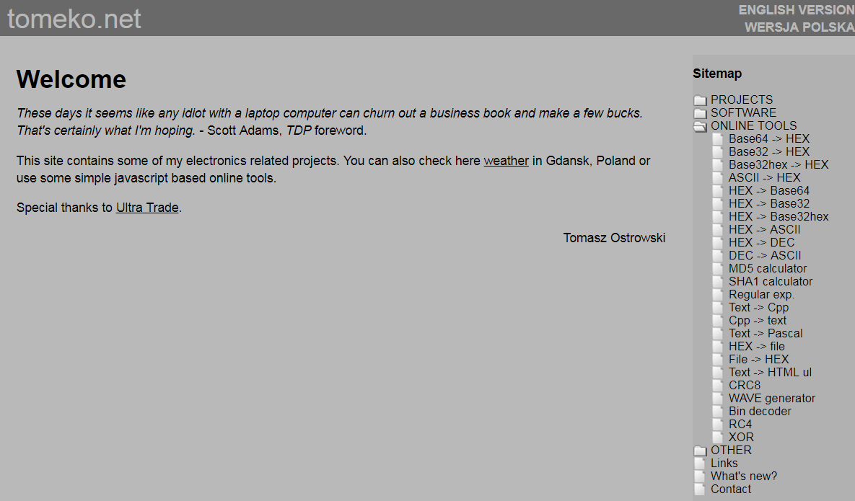

Slide 26
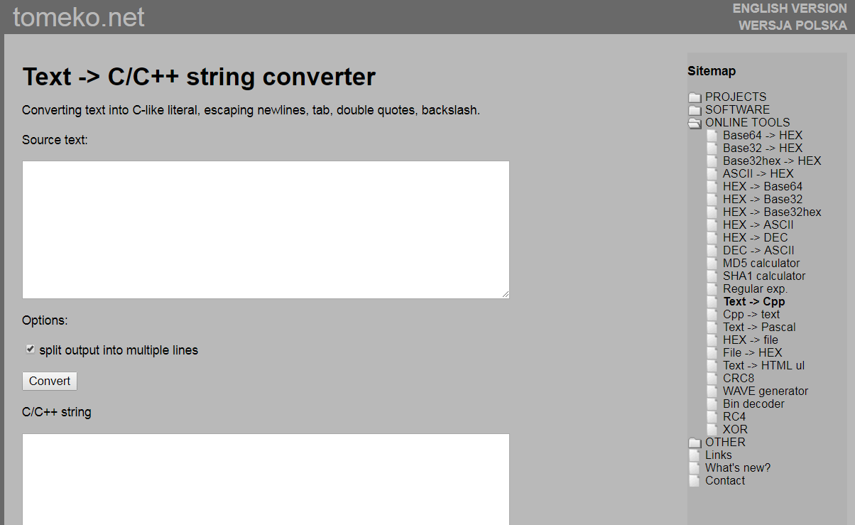

Slide 27
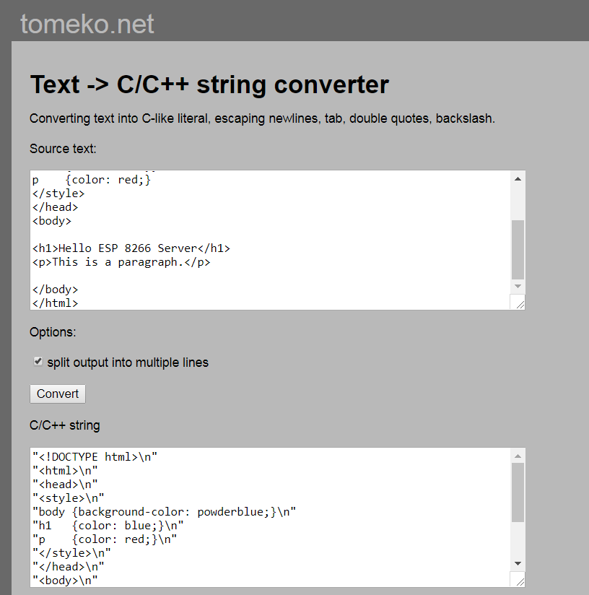

Slide 28
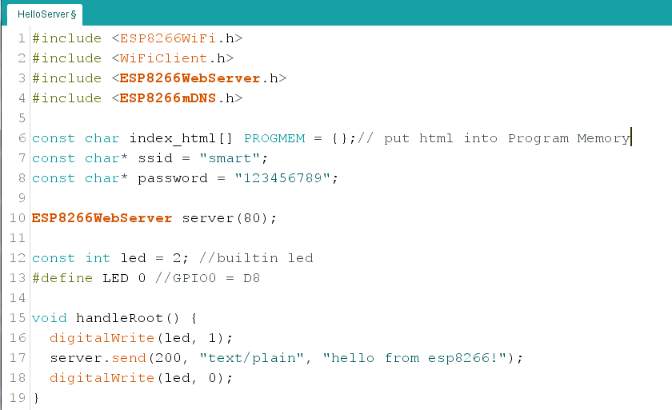

Slide 29
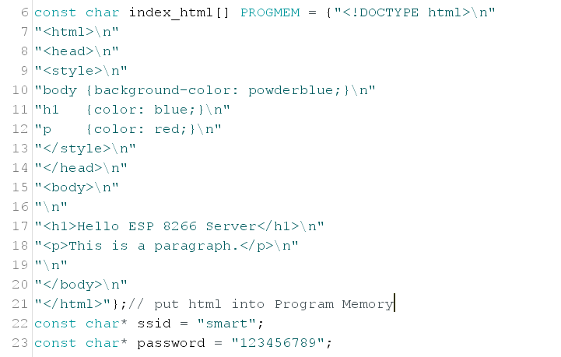

Slide 30
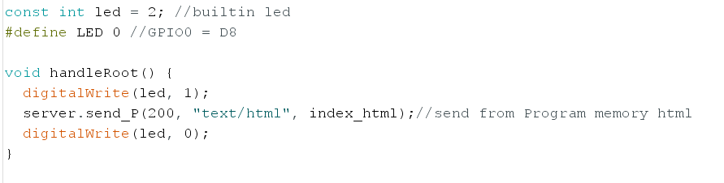
Change to index_html
Then comply and upload

Slide 31
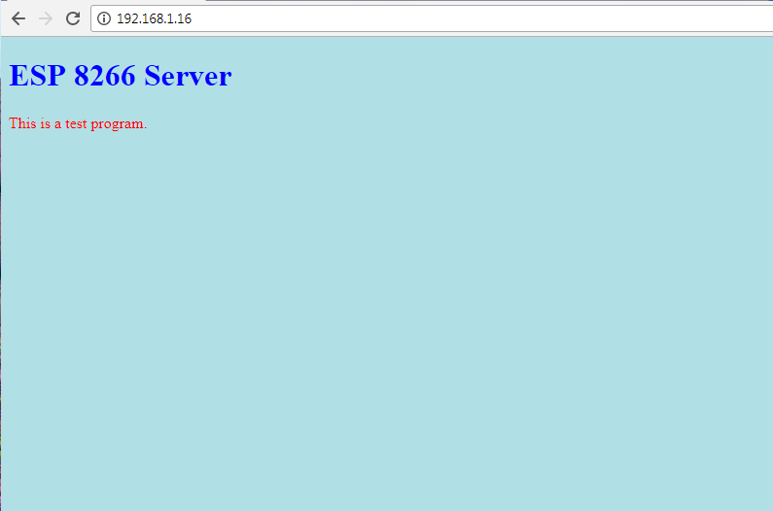
Exercise 2

Slide 32
CSS Format

Slide 33
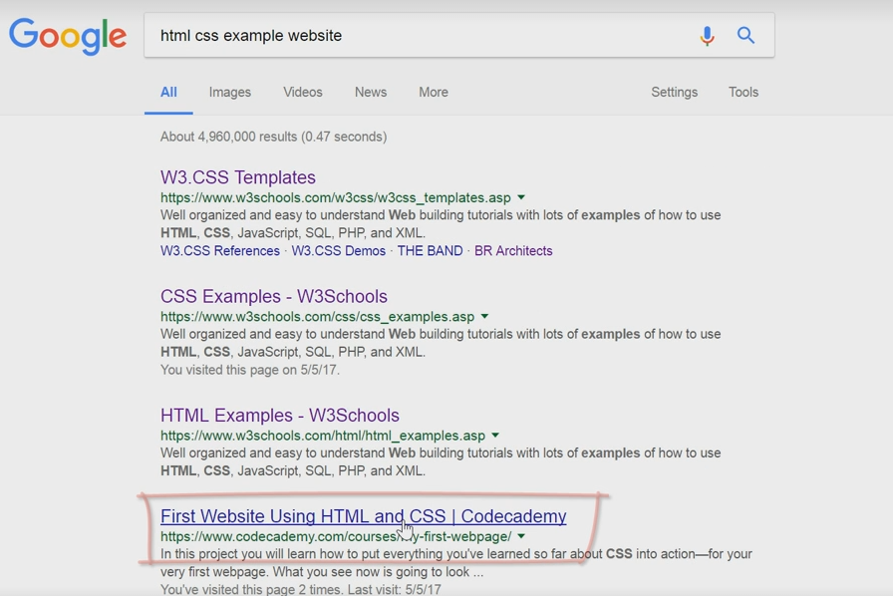

Slide 34
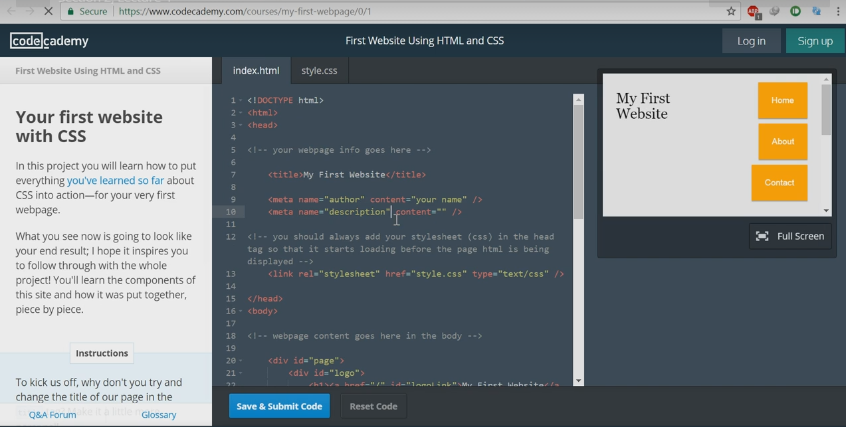

Slide 35
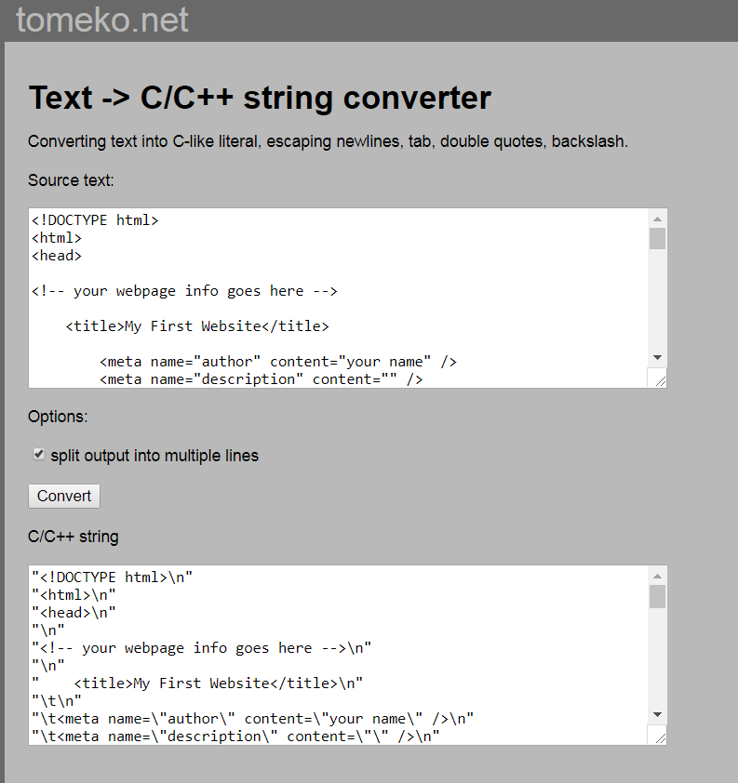
Can choose split output or in one line
Convert html to c++

Slide 36
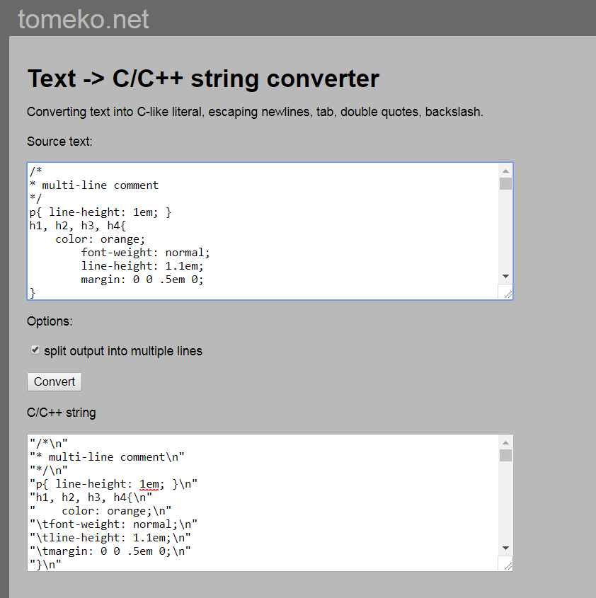
Convert css to c++
Can choose split output or in one line

Slide 37
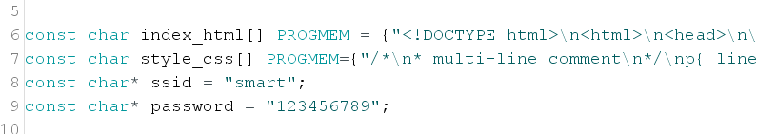
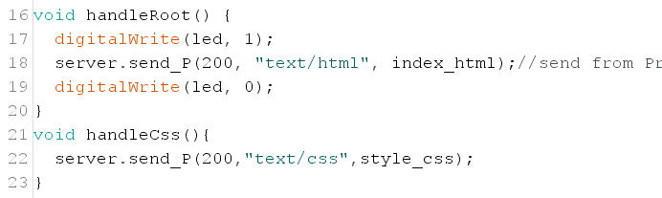
Use convert to one single line
Put converted c++ into { }
Add void handleCss()

Slide 38
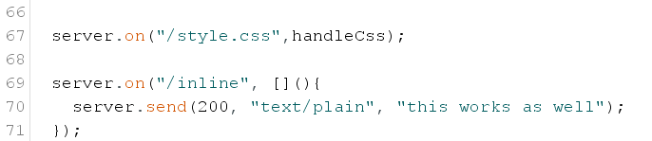
Add server.on for css
Then upload to sketch

Slide 39
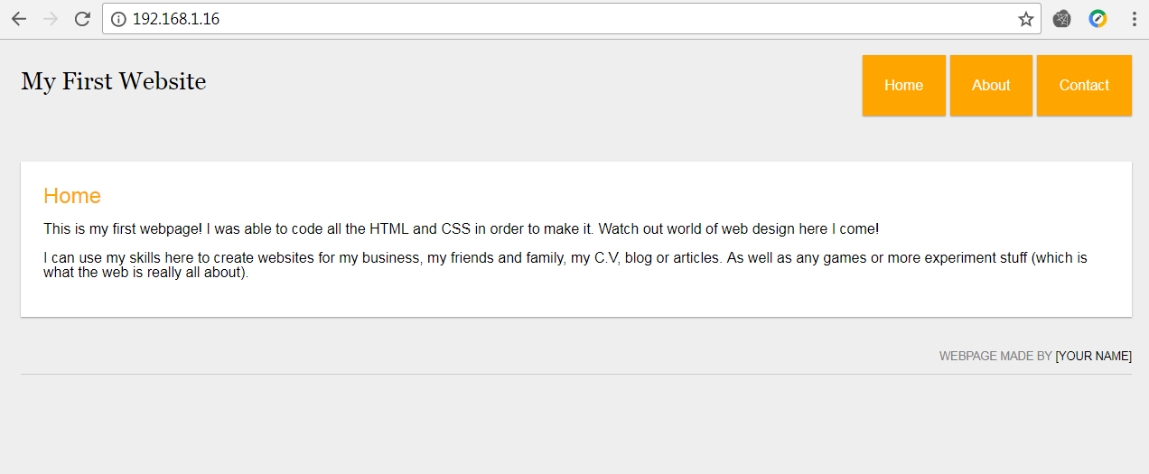
Exercise 3

Slide 40
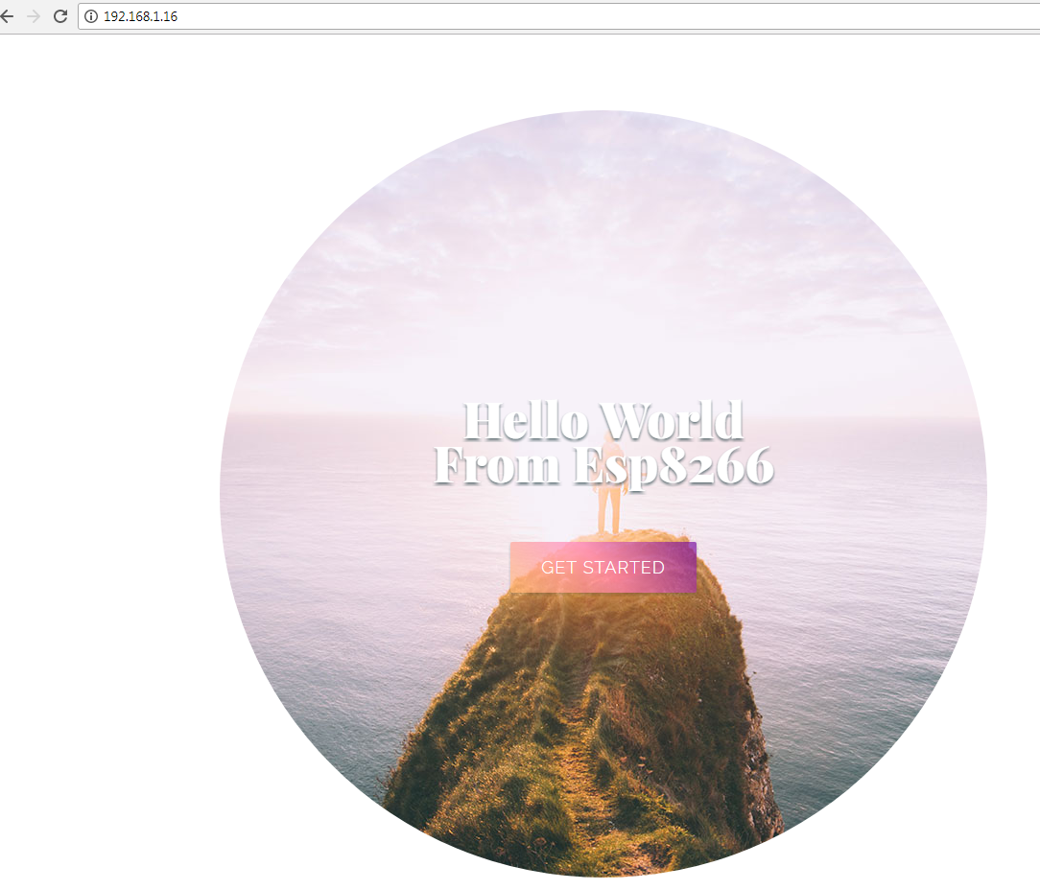
Exercise 3-1

Slide 41
Learn How to Put Photo in Html

Slide 42
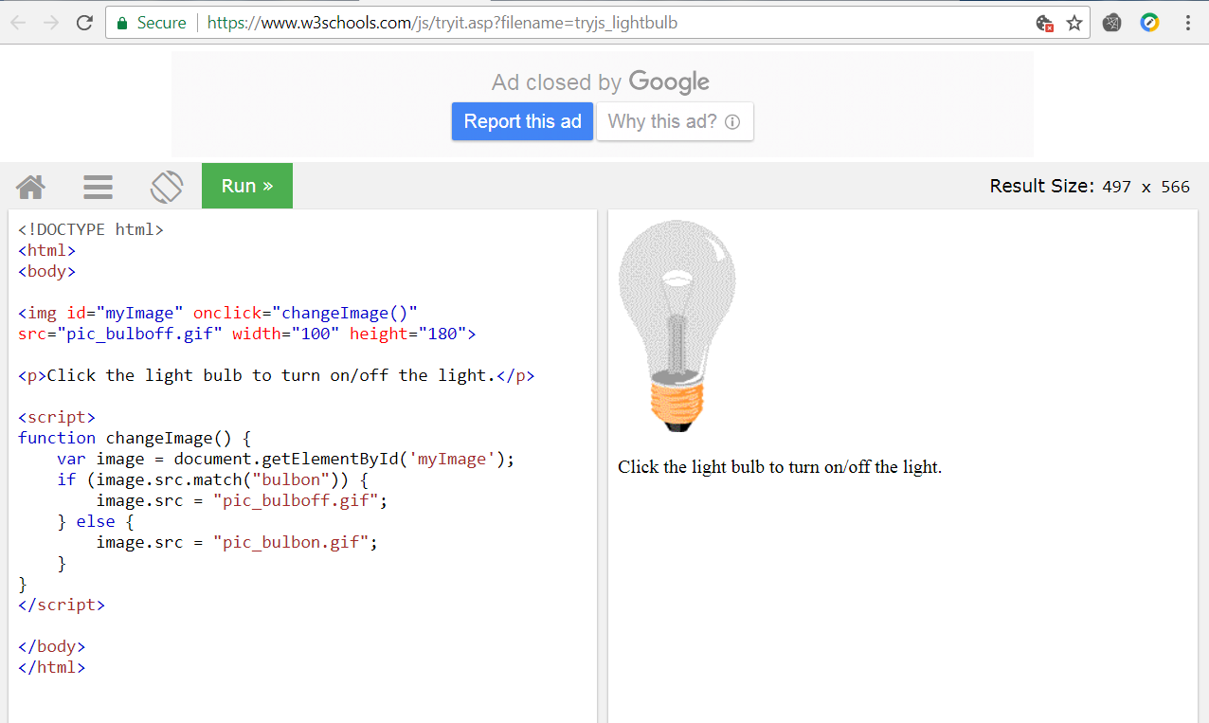

Slide 43
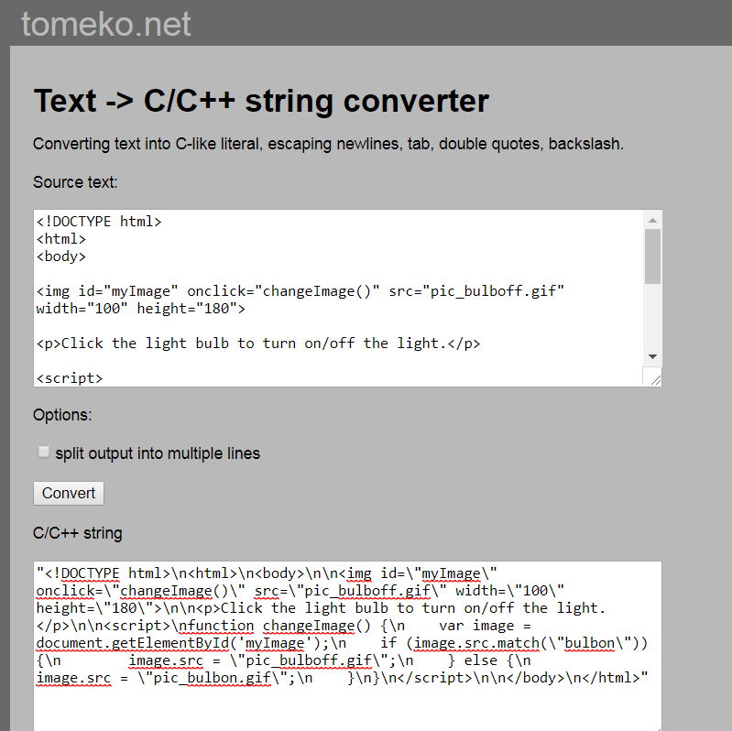
Convert html to C++

Slide 44
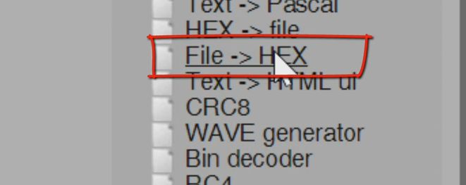


Convert fil.gif to Hex file and put into sketch

Slide 45
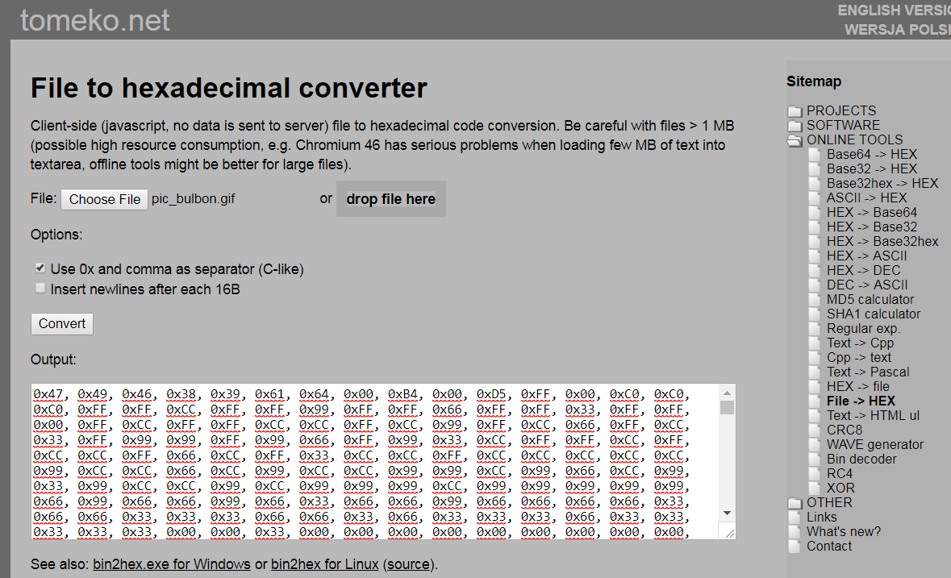

Slide 46
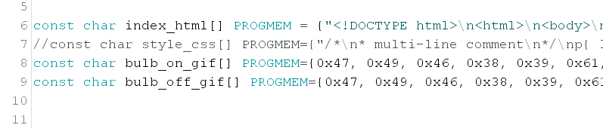
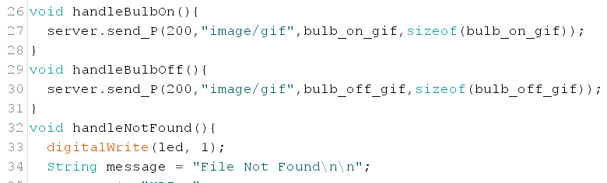
Convert photo to hex file and put in Arduino sketch
Add void handle

Slide 47
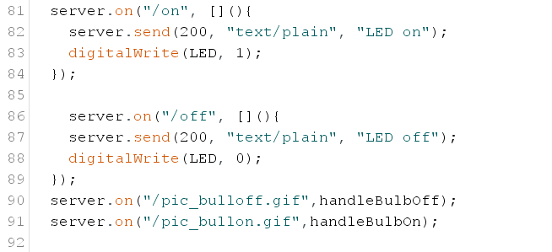
Put server.on in setup for operation
Example 4

Slide 48
With Javascript

Slide 49
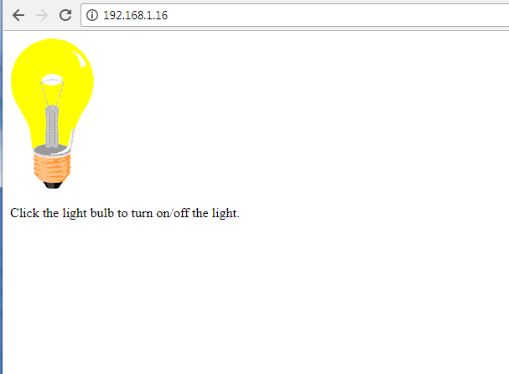
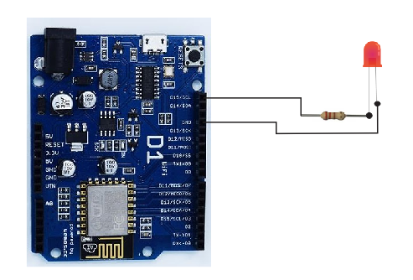
Exercise 5

Slide 50

Convert files
1.1 Convert index_html to C++
1.2 Convert jquery.min to C++
1.3 Convert myJsFunctions to C++
1.4 Put into sketch

Slide 51


Slide 52

2. Add void function

Slide 53

3. Add server.on
4. Complie and upload to sketch

Slide 54
Multiple inputs and Outputs
Example 6

Slide 55
AJAX = Asychronous Javascriprt And XML
AJAX is a misleading name. AJAX applications might use XML to transport data, but it is equally common to transport data as plain text or JSON text.
AJAX allows web pages to be updated asynchronously by exchanging data with a web server behind the scenes. This means that it is possible to update parts of a web page, without reloading the whole page.

Slide 56

How AJAX Works
1. An event occurs in a web page (the page is loaded, a button is clicked)
2. An XMLHttpRequest object is created by JavaScript
3. The XMLHttpRequest object sends a request to a web server
4. The server processes the request
5. The server sends a response back to the web page
6. The response is read by JavaScript
7. Proper action (like page update) is performed by JavaScript

Slide 57
AJAX - Send a Request To a Server
The XMLHttpRequest object is used to exchange data with a server.
Send a Request To a Server
To send a request to a server, we use the open() and send() methods of the XMLHttpRequest object:
xhttp.open("GET", "ajax_info.txt", true); xhttp.send();
Method | Description
open(method, url, async) | Specifies the type of request method: the type of request: GET or POST url: the server (file) location async: true (asynchronous) or false (synchronous)
send() | Sends the request to the server (used for GET)
send(string) | Sends the request to the server (used for POST)

Slide 58
GET or POST?
GET is simpler and faster than POST, and can be used in most cases.
However, always use POST requests when:
A cached file is not an option (update a file or database on the server).
Sending a large amount of data to the server (POST has no size limitations).
Sending user input (which can contain unknown characters), POST is more robust and secure than GET.
GET Requests
A simple GET request:
Example
xhttp.open("GET", "demo_get.asp", true); xhttp.send();

Slide 59
The url - A File On a Server
The url parameter of the open() method, is an address to a file on a server:
xhttp.open("GET", "ajax_test.asp", true);
The file can be any kind of file, like .txt and .xml, or server scripting files like .asp and .php
(which can perform actions on the server before sending the response back).
Asynchronous - True or False?
Server requests should be sent asynchronously.
The async parameter of the open() method should be set to true:
xhttp.open("GET", "ajax_test.asp", true);
By sending asynchronously, the JavaScript does not have to wait for the server response, but can instead:
execute other scripts while waiting for server response
deal with the response after the response is ready

Slide 60
ตย. XMLHttpRequest Object AJAX
<!DOCTYPE html>
<html>
<body>
<h2>The XMLHttpRequest Object</h2>
<p id="demo">Let AJAX change this text.</p>
<button type="button" onclick="loadDoc()">Change Content</button>
<script>
function loadDoc() {
var xhttp = new XMLHttpRequest();
xhttp.onreadystatechange = function() {
if (this.readyState == 4 && this.status == 200) {
document.getElementById("demo").innerHTML = this.responseText; } };
xhttp.open("GET", "ajax_info.txt", true);
xhttp.send();}
</script>
</body>
</html>
Create “ajax_info.txt”
Save html file
Run in browser (firefox)

Slide 61
Java script object notation (JSON)
JSON is a syntax for storing and exchanging data.
JSON is text, written with JavaScript object notation.
Exchanging Data
When exchanging data between a browser and a server, the data can only be text.
JSON is text, and we can convert any JavaScript object into JSON, and send JSON to the server.
We can also convert any JSON received from the server into JavaScript objects.
This way we can work with the data as JavaScript objects, with no complicated parsing and translations.
Sending Data
If you have data stored in a JavaScript object, you can convert the object into JSON, and send it to a server:

Slide 62
<!DOCTYPE html>
<html>
<head>
<title>Esp8266 I/O</title> //title of browser
<link rel="stylesheet" type="text/css" href="css/style.css">
<script src="js/jquery.min.js"></script>
<script>
$(document).ready(function() {
setInterval("get_digital_output_status()", 2000);
});
function get_digital_output_status() { var someUrl = "/digital_outputs";
$.ajax({url: someUrl,dataType: "json",success: function(response) { //send data to a web server
if (response.digital_outputs["dout1"] == 1) $("#dout1").html("HIGH")
else $("#dout1").html("LOW")
if (response.digital_outputs["dout2"] == 1) $("#dout2").html("HIGH")
else $("#dout2").html("LOW")
if (response.digital_outputs["dout3"] == 1) $("#dout3").html("HIGH")
else $("#dout3").html("LOW")
if (response.digital_outputs["dout4"] == 1) $("#dout4").html("HIGH")
else $("#dout4").html("LOW")}})}
การใช้ ajax คู่กับ json

